Slide 1
Innovative Kherson Region:
steps on implementation
LLC Tehnosistema
Инновационная Херсонщина: шаги к внедрению

Slide 2
Name of the project
Construction of a united (Internet + TV + telephone + video surveillance) cellular digital terrestrial and cable broadcasting telecommunication network based on technology of microwave integrated television and radio information system (MITRIS) in the Kherson region.

Slide 3
Innovative components of the project
Implementation of television product of HDTV standard 100% coverage of the region with a united Telecommunication Network (Internet + TV + Phone + video surveillance). This offer "three-in-one" is the first of its kind in the telecommunications market of Ukraine.

Slide 4
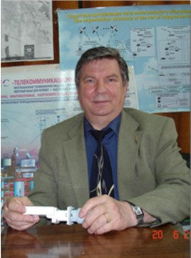
Development of technology and equipment – Ukrainian production
JV Institute of Electronics and Communications of Ukrainian Academy of Sciences
Supervisor of scientific and technical work к. т. н. Academician of the Ukrainian Academy of Sciences Narytnik T. M.

Slide 5
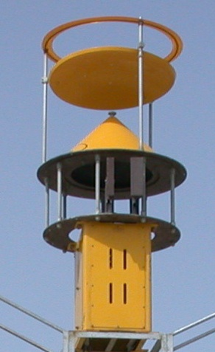
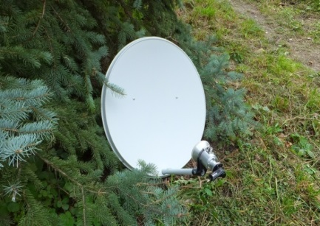
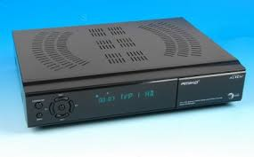
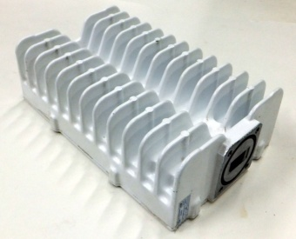
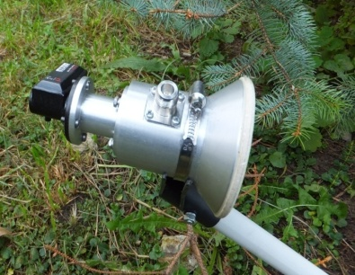
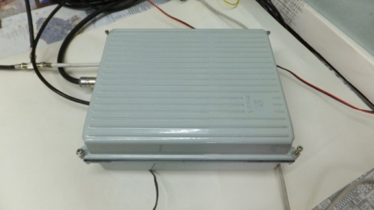
Product
Complex of equipment for providing
wireless multi-service access to information services
Retransmission in the broadcasting and cable networks, in the digital mode and HDTV standard of up to 200 television channels, the Internet and transmission of video data in a single network with 100% coverage of the Kherson region.

Slide 6
Spheres of implementation:
video surveillance
Central Station
microwave TV
User station
local wireless network
Cable television
IP telephony
computer network

Slide 7
Basic numbers of the project
The project pays off with the monthly subscription fee.
The marketing strategy is based on building our own branded retail network.
Payback period of 50 months.
The total cost of the project -
8 million 400 thousand Euro

Slide 8
Marketing information:
In the Kherson region outside areas of coverage of cable television and internet networks there are 46 thousand apartments, 250 thousand private households, about 40 thousand 798 rooms in boarding houses on the coasts of the Azov and Black Seas, 55-65 thousand of potential subscribers in 553 schools of the region and 4486 budget organizations. The total number of subscribers for theses types of activities is about 350-400 thousand.

Slide 9
Perspectives of MITRIS development
National project "Open World"
The concept of "Safe City"
The concept of "Smart City"
National Strategy "Development of television and radio space in the Kherson region and Crimea»
The realization of this project will promote the development of national information and telecommunications infrastructure based on the MITRIS technology (According to the statement of Cabinet of Ministers of Ukraine №294 dated 12.03.2012).

Slide 10
Directions of development
FIRST
The agreement of synchronization networks TRC "Zahidteleservis" m. Lviv
SECOND
Implementation of the idea of "Southern way" - a common telecommunication space

Slide 11
DIGITAL BROADCASTING WILL BE READY ON
30/06/17

